Slide 1
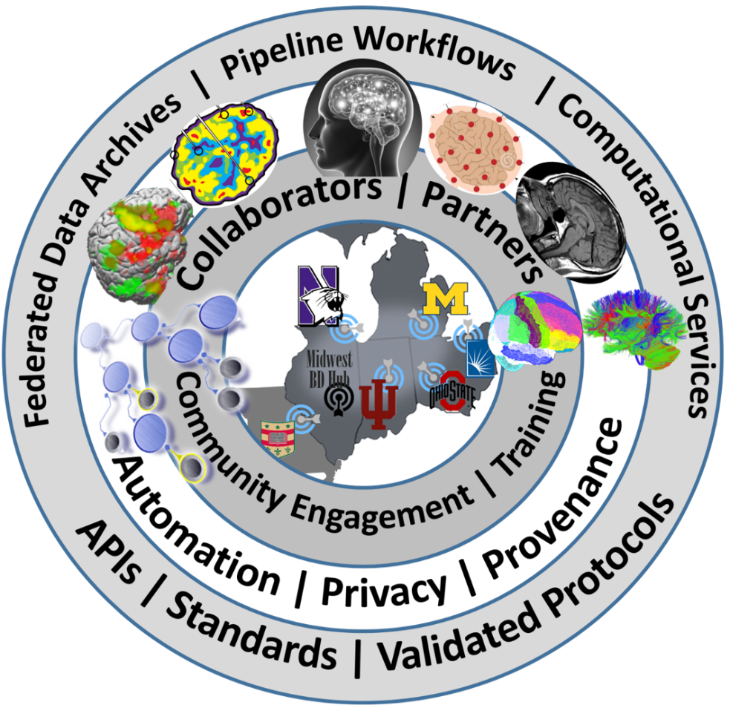

Computational Neuroscience Network (ACNN)
Rich Gonzalez & Ivo D. Dinov
http://www.NeuroscienceNetwork.org

Slide 2
ACNN Team
University of Michigan: Ivo Dinov, Rich Gonzales, John Marcotte
(George Alter)
Indiana University: Franco Pestilli, Olaf Sporns, Andrew Saykin
OSU: DK Panda, Xiaoyi Lu, Hari Subramoni
CWRU: Satya Sahoo
Washington University: Daniel Marcus
Northwestern University: Lei Wang
USC: Jose-Luis Ambite

Slide 3
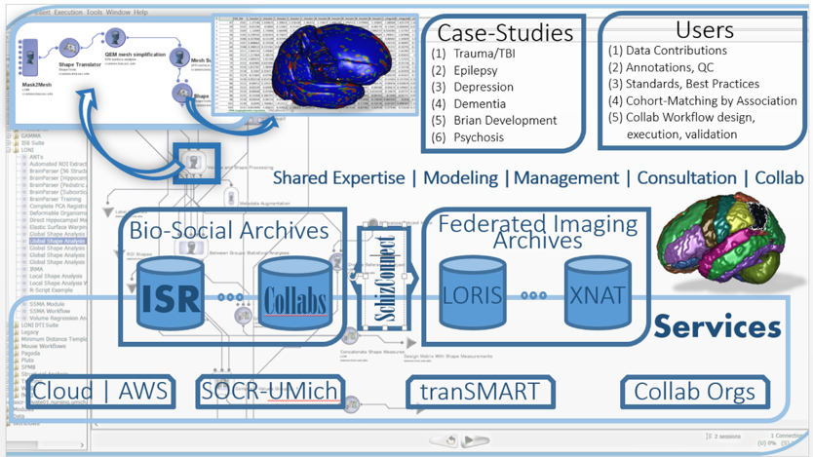
ACNN Computational Infrastructure

Slide 4
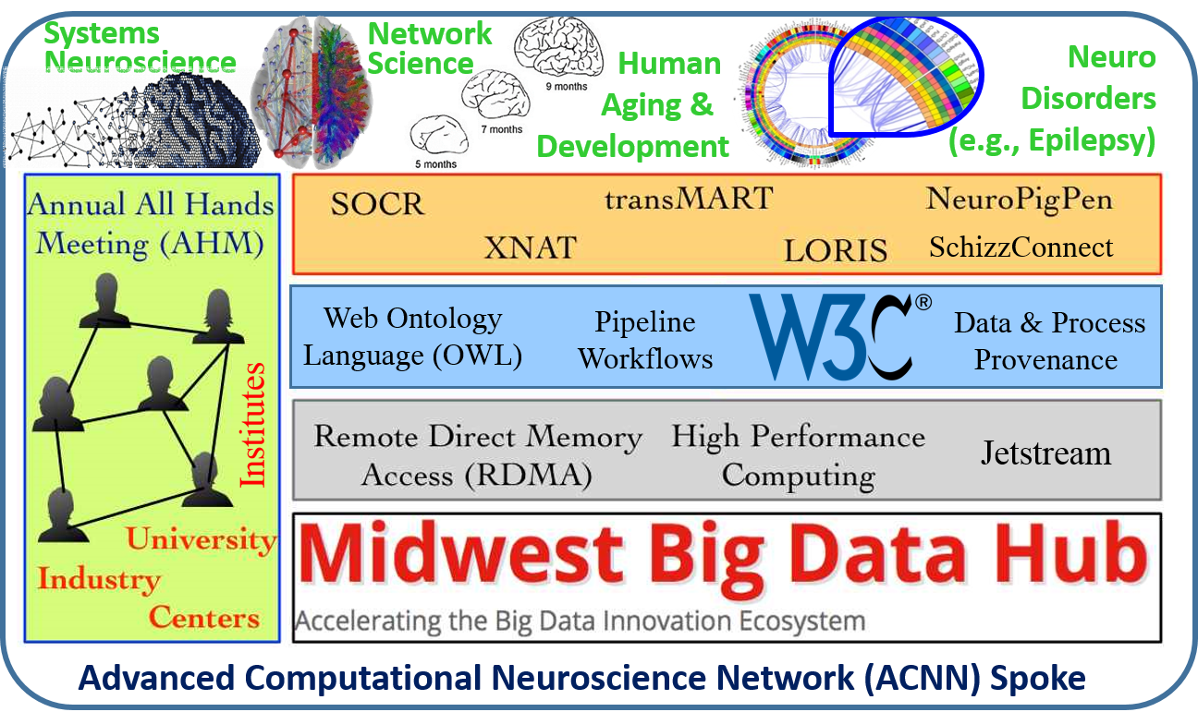
ACNN Services

Slide 5


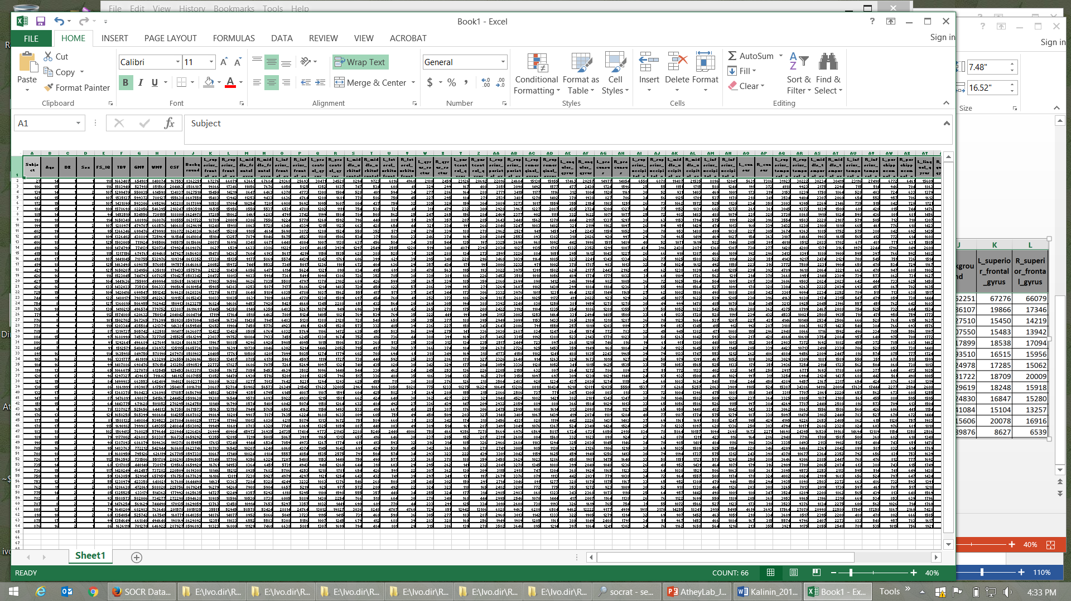

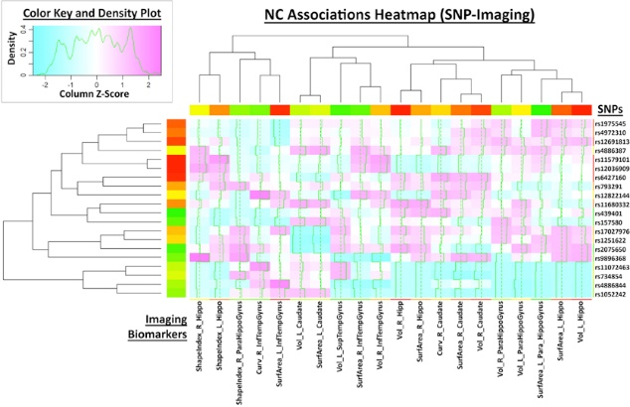
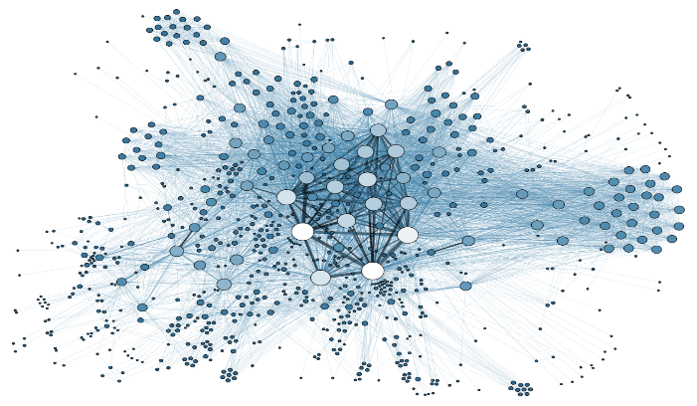
Big Neuroscience Data
TBD
Data
Wrangling
Data
Modeling
Data
Analytics
Data
Visualization

Slide 6
Examples of Big Neuroscience Data
Case-Studies | Sample-size | Data Elements | Description
ALS | Longitudinal data for 8K patients (data comes from 2 independent EU registries) | >300 variables including incomplete clinical, physiological, and cognitive data | This case-study needs innovative machine learning methods for automated diagnostic classification (e.g., patients vs. controls) and unsupervised prediction of cognitive and behavioral decline in ALS patients. The multi-source data will be partitioned into training (estimation) and testing (validation) sets. We plan to fit different models and estimate model-free classifiers to either cluster the participants into groups or hierarchies, or to forecast the progression of the disease over time
Depression / SZ | Extremely large longitudinal data (ms samples), 150 subjects | Study design includes 20 (2*2*5) stimuli types, 12 electrode locations, 1,000’s of ms measurements, 4 summary measures | This case-study is focused on identifying a set of P300 biomarkers (using the incomplete high frequency data) that can classify the core cohorts (Bipolar, Schizophrenia, Depression, and healthy controls). We also aim to investigate if P300 responses to emotional stimuli classify the groups better than those to non-emotional stimuli (from standard Go/NoGo tasks). Mean and peak amplitude and latency are candidates based on previously reported results
PD | 550 PPMI subjects with 1-10 observation time points | Demographics, clinical tests, vital signs, MDS-UPDRS scores, ADL, MoCA, sMRI, ESS Sleepiness Scale, GDS-15, genetics | Using heterogeneous data of Parkinson’s Disease (PD), the study aims to develop a comprehensive end-to-end protocol for data characterization, manipulation, processing, cleaning, analysis and validation. Specifically: (1) introduce methods for rebalancing imbalanced cohorts, (2) utilize a wide spectrum of classification methods to generate consistent and powerful phenotypic predictions, and (iii) generate reproducible machine-learning based classification that enables the reporting of model parameters and diagnostic forecasting based on new data
TBI / Trauma | Over 2,000 patients and controls, acute and multiple chronic times | Dozens of structured (imaging, phenotypic, clinical) and unstructured (injury type, notes) data elements | Three major data sets are included: Volumetric in Brain Trauma (VBT), HeadSmat, and PROTECT II. Each of these datasets include patient’s brain CT and/or MRI scans at time of admission, and in some cases during ICU stay, and even during long-term follow up after hospital discharge. These datasets also include time-course data on some physiological measures and blood factors, captured throughout the course of treatment. The UMich/Massey Foundation Grand Challenge provides additional motivation and testing data. The PIs are involved in research funded by this foundation to integrate and analyze these datasets

Slide 7
Characteristics of Big Brain Data
IBM Big Data 4V’s: Volume, Variety, Velocity & Veracity
BBD Dimensions | Tools
Size | Harvesting and management of vast amounts of data
Complexity | Wranglers for dealing with heterogeneous data
Incongruency | Tools for data harmonization and aggregation
Multi-source | Transfer and joint modeling of disparate elements
Multi-scale | Macro to meso to micro scale observations
Incomplete | Reliable management of missing data
Example: analyzing observational data of 1,000’s Parkinson’s disease patients based on 10,000’s signature biomarkers derived from multi-source imaging, genetics, clinical, physiologic, phenomics and demographic data elements.
Software developments, student training, service platforms and methodological advances associated with the Big Data Discovery Science all present existing opportunities for learners, educators, researchers, practitioners and policy makers
Dinov (2016)
Notes:
What is Big Brain Data? Big data is very different from traditional (small) data due to the exotic challenges it presents and because of its potential to revolutionize our understanding of the world around us. There are 6 characteristics that make Big Data unique. These 6-dimensions (6Ds) of Big Data are defined by its unique attributes: (1) Size – the volume of data exceeds standard storage, memory and computational capabilities, (2) Incongruency – samples, cases and observations in the data may be highly non-homologous, which requires special treatment during the data analytics phase, (3) Incompleteness – Big Data may be sparse with (random and non-random causes of) missing values due to the en masse nature of generation and collection of data elements, (4) Complexity – as the dimension of the data increases distance metrics between observations become degenerate (curse of dimensionality) leading to considerable computational and interpretation challenges, (5) Multi-scale – Big Data frequently includes observations from micro to meso to macro levels, across time, space and frequency spectra, and (6) Multi-source – numerous digital, analogous and mixed data is produced by devices and instruments demand integration (fusion) of relevant data within and beyond the scope of any specific research study. These 6Ds allow us to begin the processes of model, algorithm and tool development necessary to cope with the specific challenges that make “standard scientific methods” impractical for Big Data. Big Data science is team-based and highly trans-disciplinary. It requires diverse, broad, and complementary expertise, specialized training, continuous development efforts, high-throughput analytics, and powerful techniques for data interrogation. The scope of Big Data challenges are illustrated by the problem of analyzing observational data of 1,000’s Parkinson’s disease patients based on 10,000’s signature biomarkers derived from multi-source imaging, genetics, clinical, physiologic, phenomics and demographic data elements. Similar data-driven exploratory and confirmatory analytic examples can be demonstrated in other disciplines. Software developments, student training, service platforms and methodological advances associated with the Big Data Discovery Science all present existing opportunities for learners, educators, researchers, practitioners and policy makers
http://www.onlinecharttool.com/graph?selected_graph=radar

Slide 8
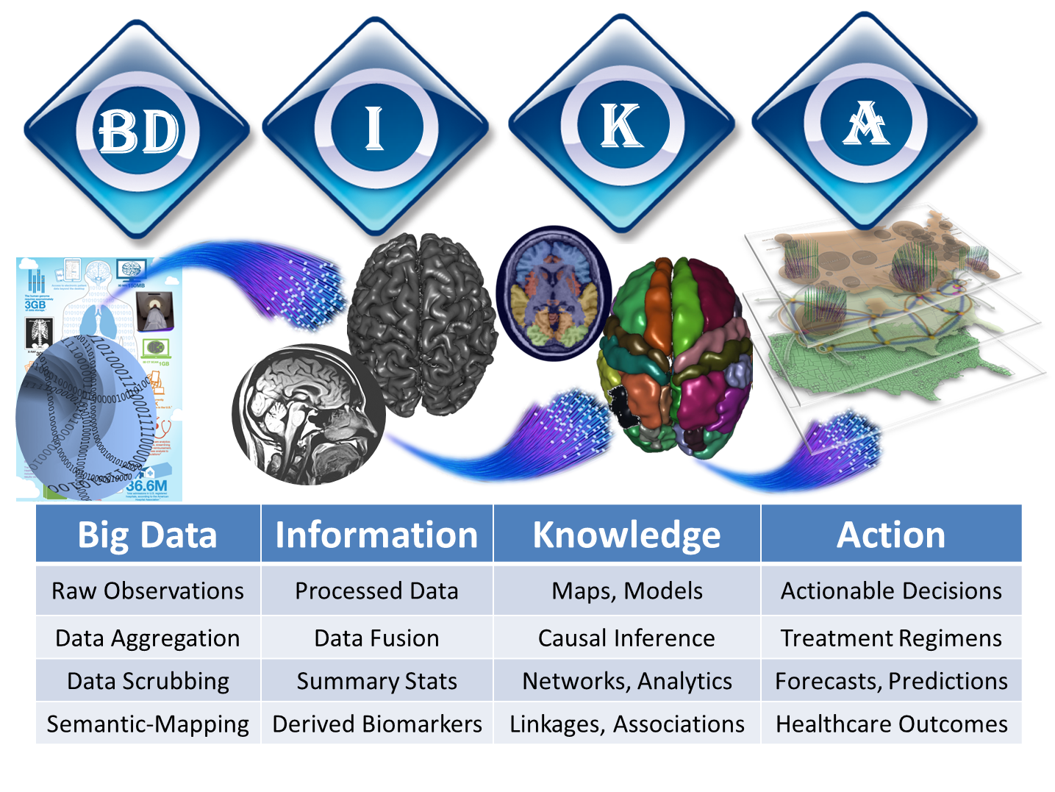
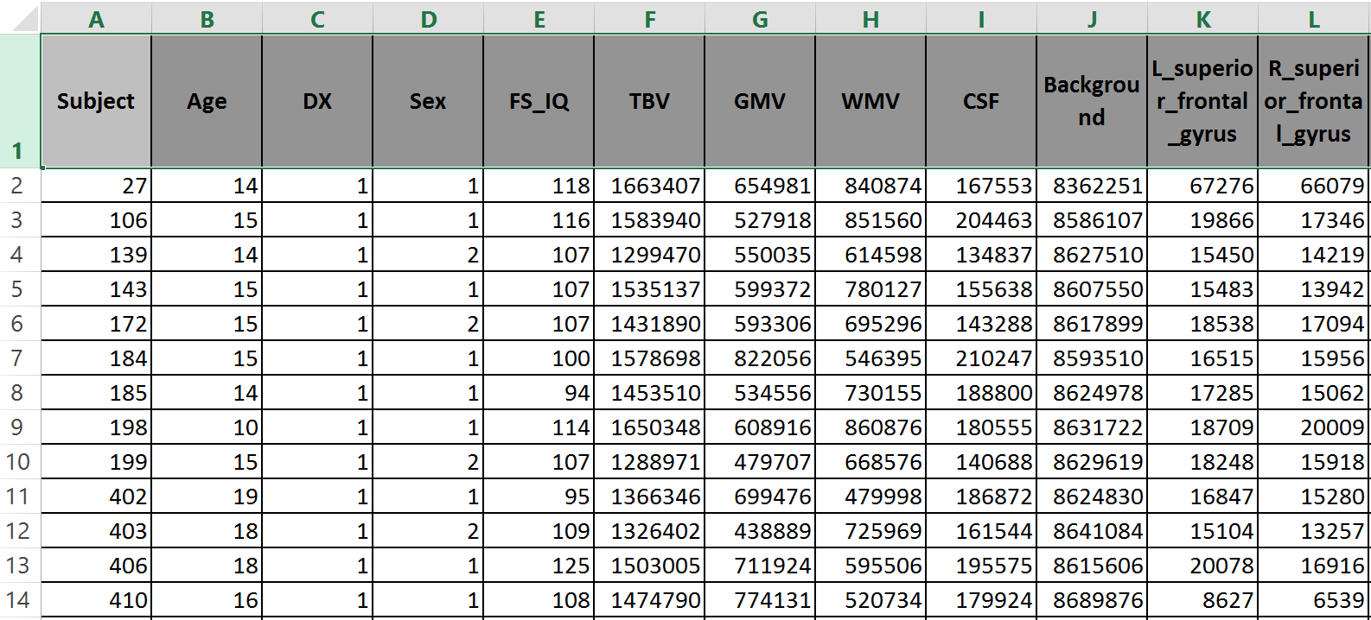

Normal & Schizophrenia
Pediatric Neuroimaging Study

Slide 9
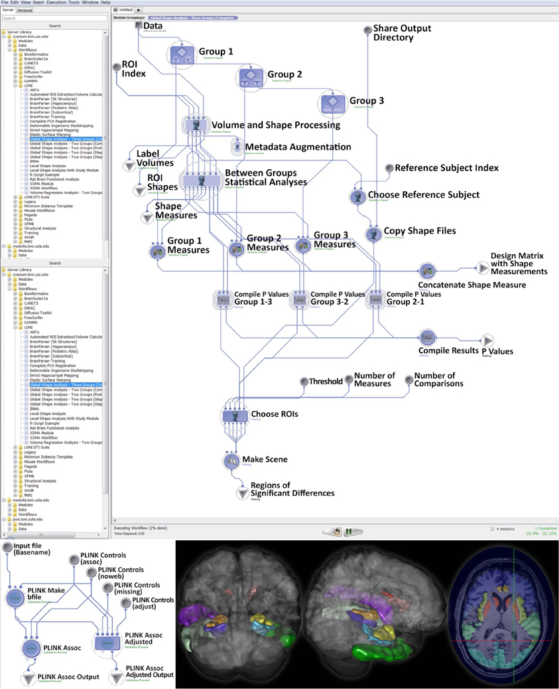
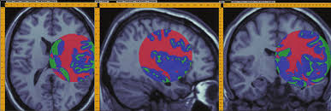
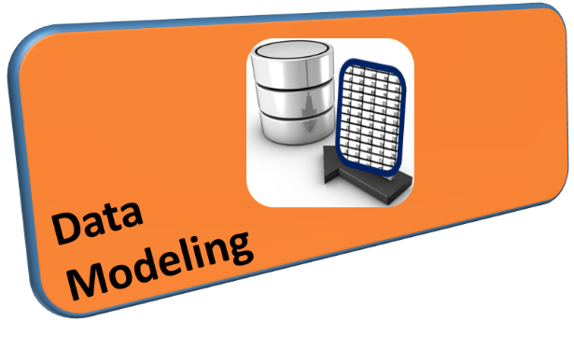

Slide 10
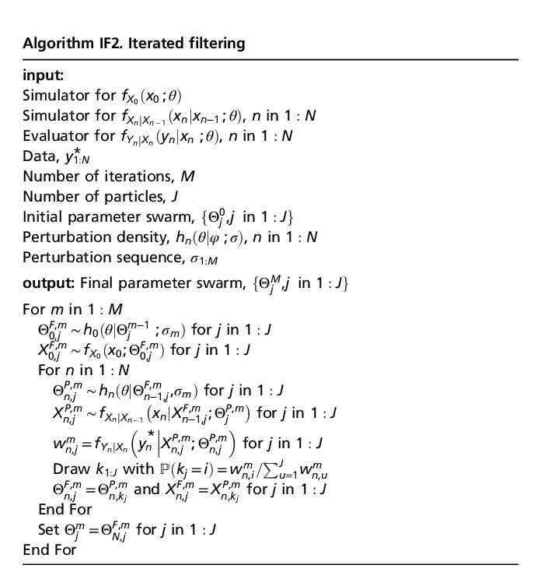
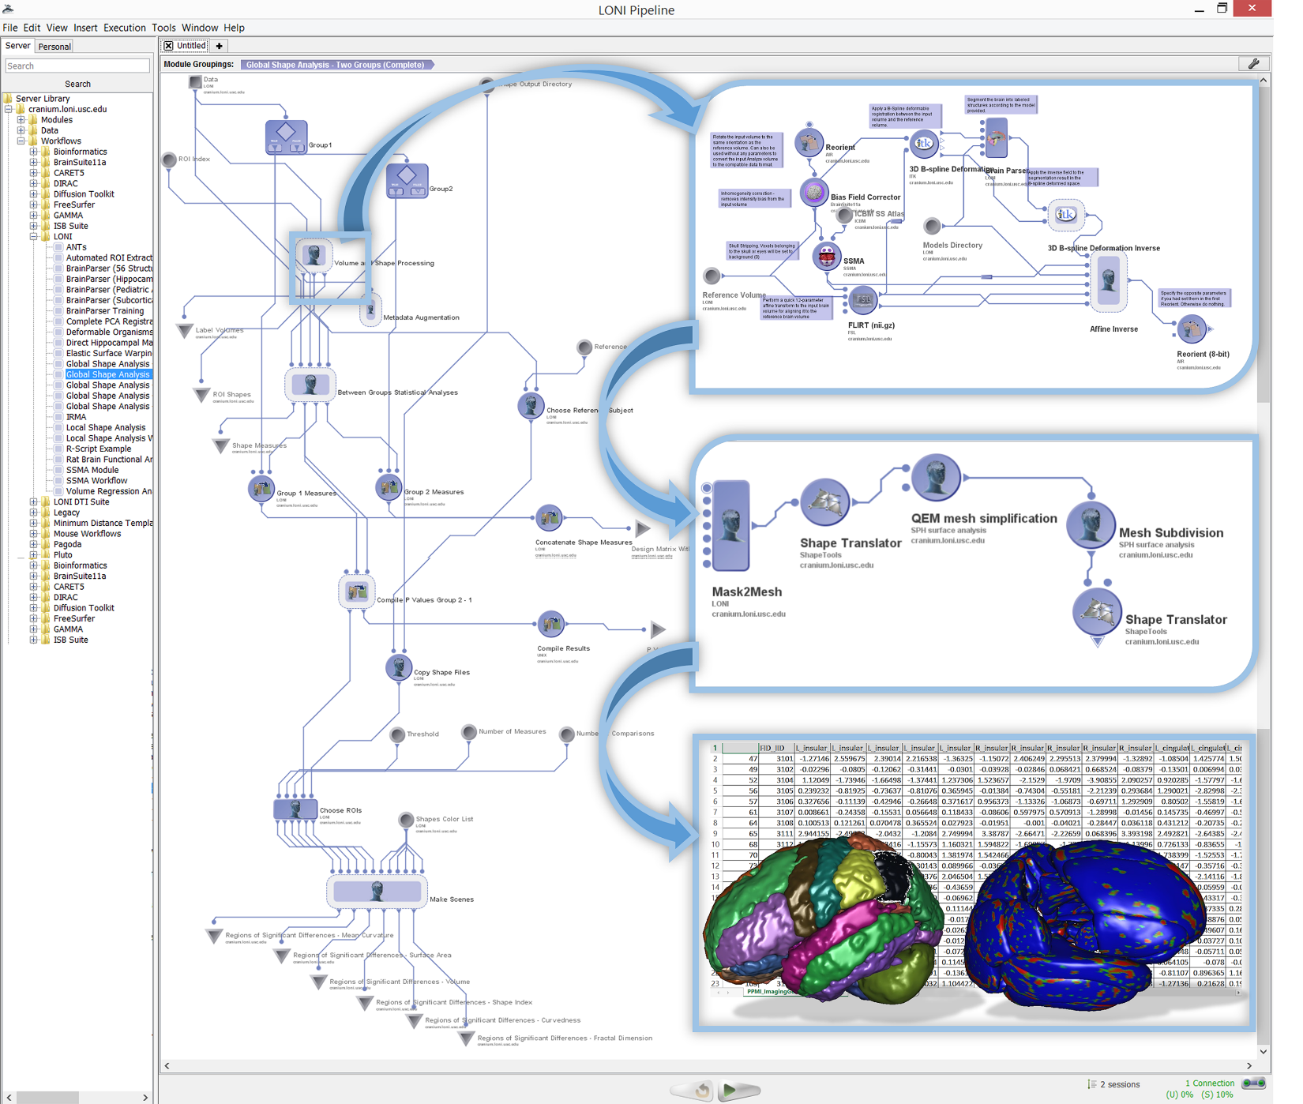
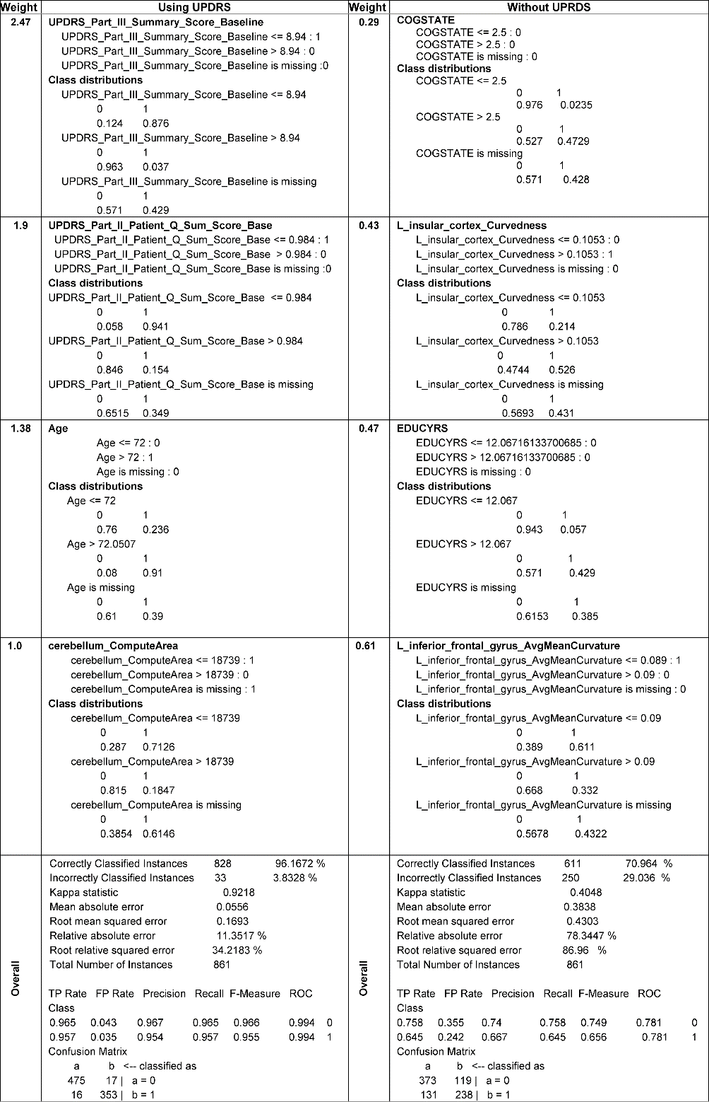
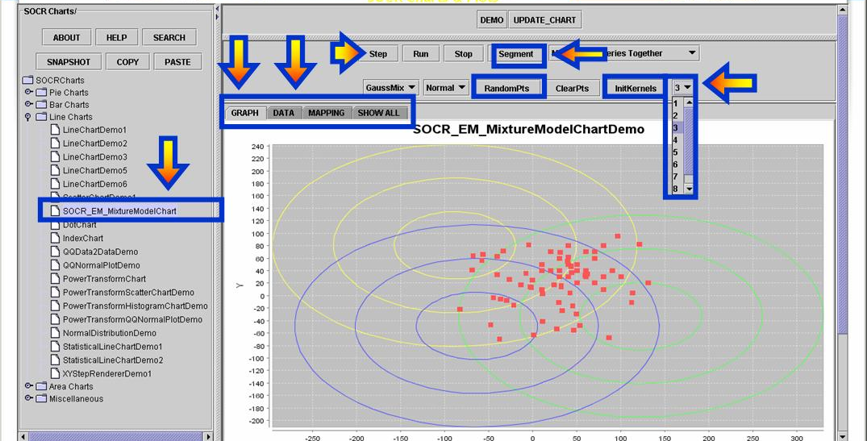
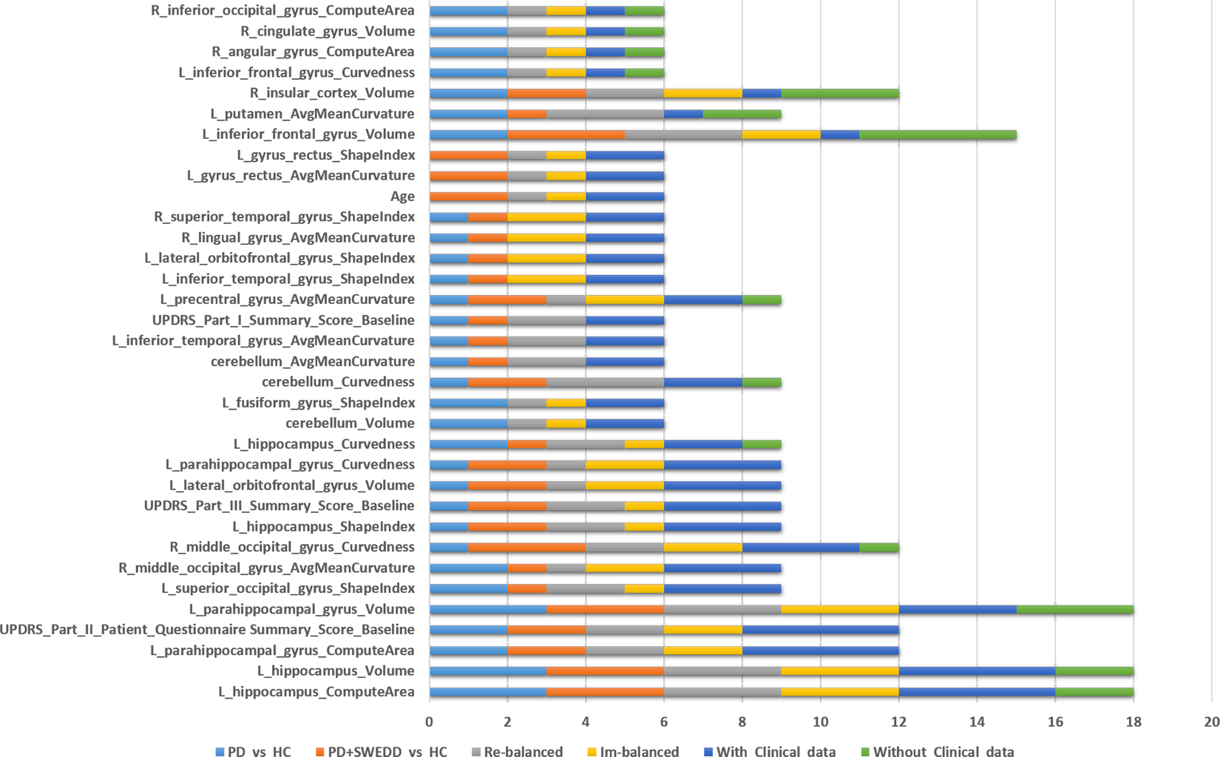
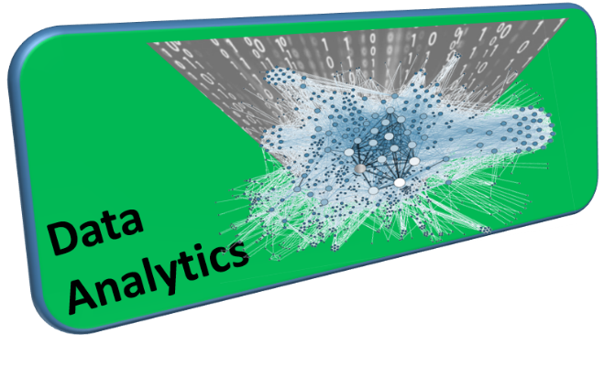
PMID:27494614

Slide 11
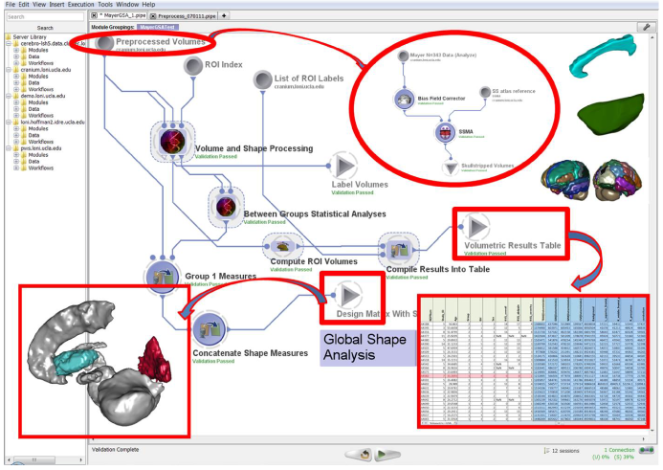
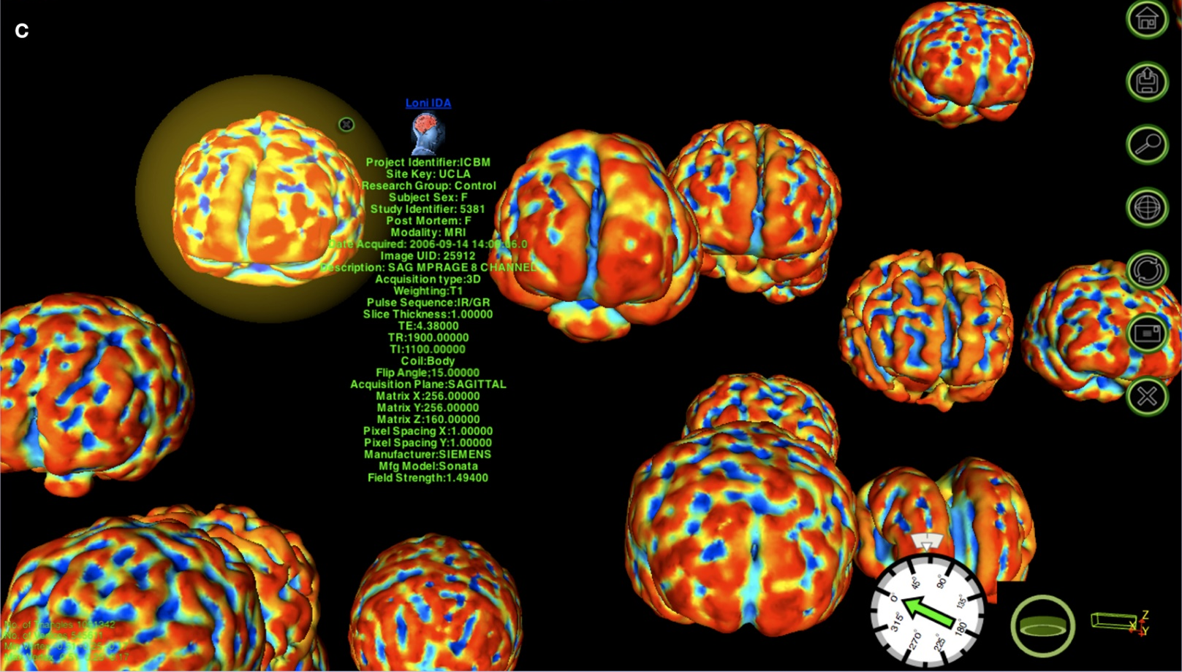
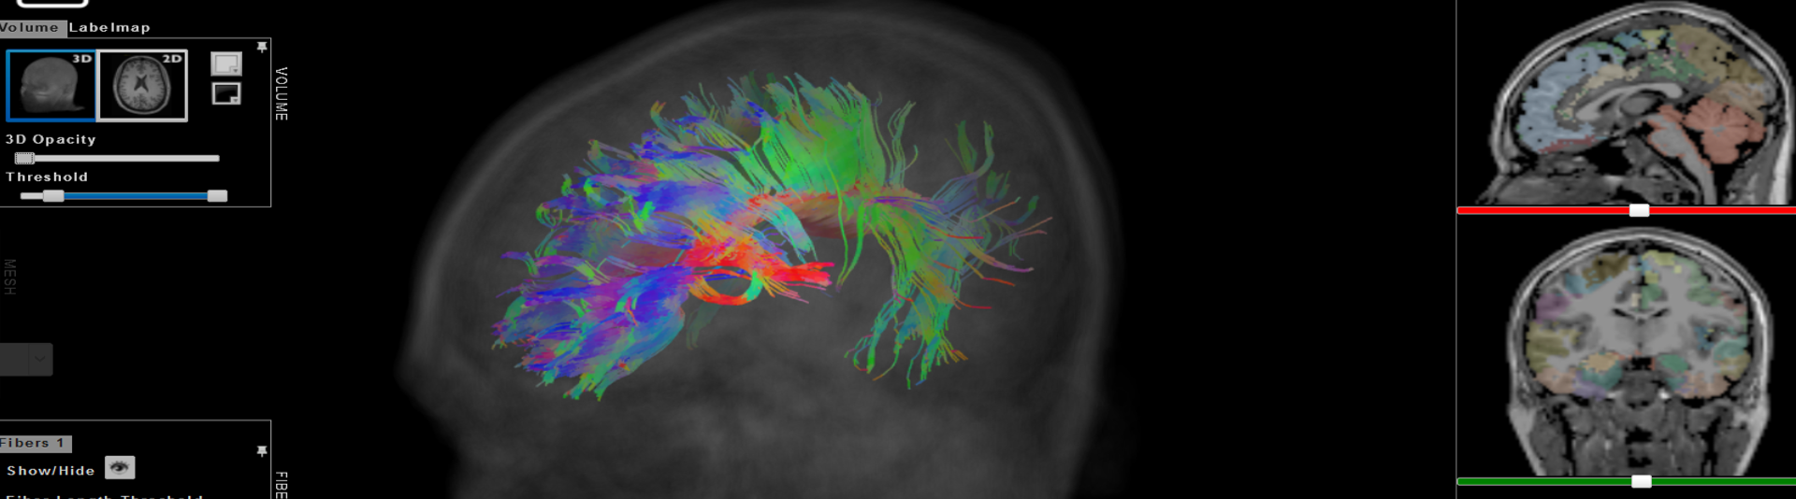
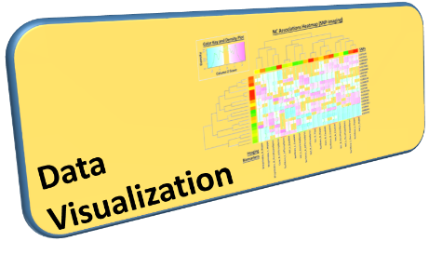
http://socr.umich.edu/HTML5/BrainViewer

Slide 12
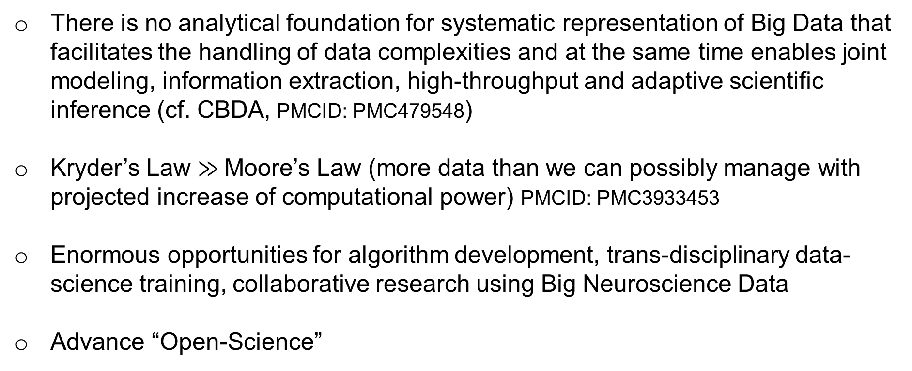
Gaps, Barriers & Opportunities
There is no analytical foundation for systematic representation of Big Data that facilitates the handling of data complexities and at the same time enables joint modeling, information extraction, high-throughput and adaptive scientific inference (cf. CBDA, PMCID: PMC479548)
Kryder’s Law $≫$Moore’s Law (more data than we can possibly manage with projected increase of computational power) PMCID: PMC3933453
Enormous opportunities for algorithm development, trans-disciplinary data-science training, collaborative research using Big Neuroscience Data
Advance “Open-Science”

Slide 13
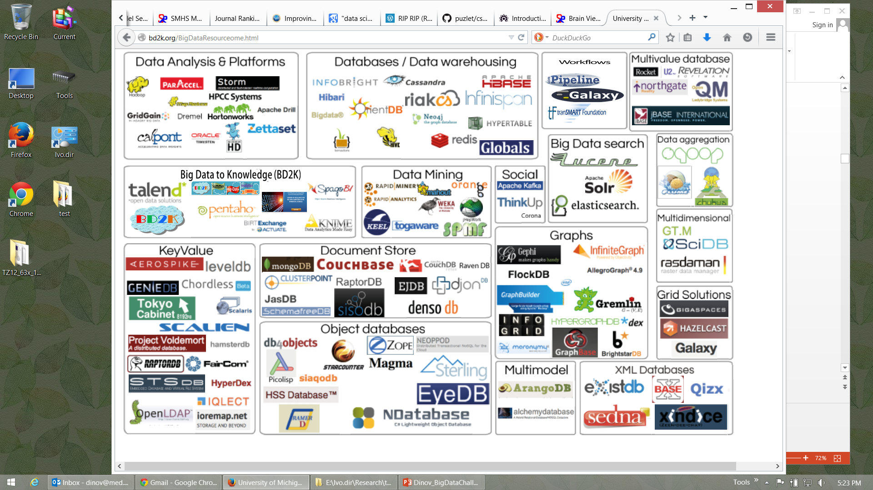




Big Data Analytics Resourceome
http://socr.umich.edu/docs/BD2K/BigDataResourceome.html
Notes:
http://bd2k.org/BigDataResourceome.html

Slide 14
Examples of Available Resources
Source Code: https://github.com/SOCR
End-to-End Pipeline Workflows:
Docs: https://wiki.loni.usc.edu
Protocols: http://pipeline.loni.usc.edu/explore/library-navigator
Pubs: http://www.socr.umich.edu/people/dinov/publications.html
Training/Learning Resources: http://wiki.socr.umich.edu/index.php/SMHS
Data:
Classical: http://wiki.socr.umich.edu/index.php/SOCR_Data
Case-Studies: https://umich.instructure.com/courses/38100/files/folder/Case_Studies

Slide 15
Distributed Services
Processing
Pipeline Try-It-Now Graphical Workflow Environment
(Guest access): http://pipeline.loni.usc.edu/products-services/pws/
socr-pipeline.nursing.umich.edu
AWS/Galaxy: http://GalaxyProject.org
tranSMART: https://github.com/transmart
Data
dbGaP http://dbgap.ncbi.nlm.nih.gov
Neuroimaging http://IDA.loni.usc.edu
XNAT: https://central.xnat.org
Transfer
Globus: http://www.globusonline.org
GridFTP: http://toolkit.globus.org/toolkit/docs/latest-stable/gridftp/

Slide 16
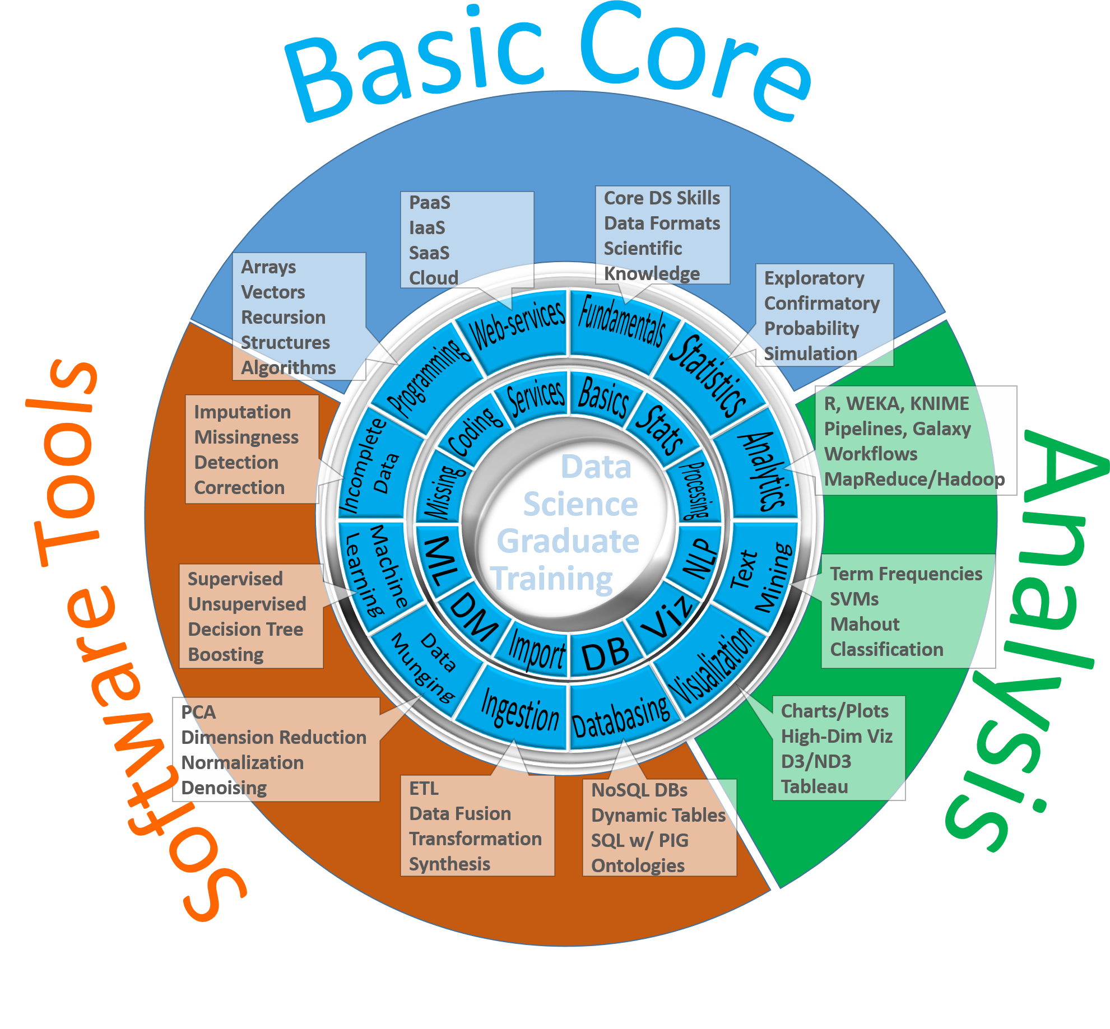
Data Science Education

Slide 17
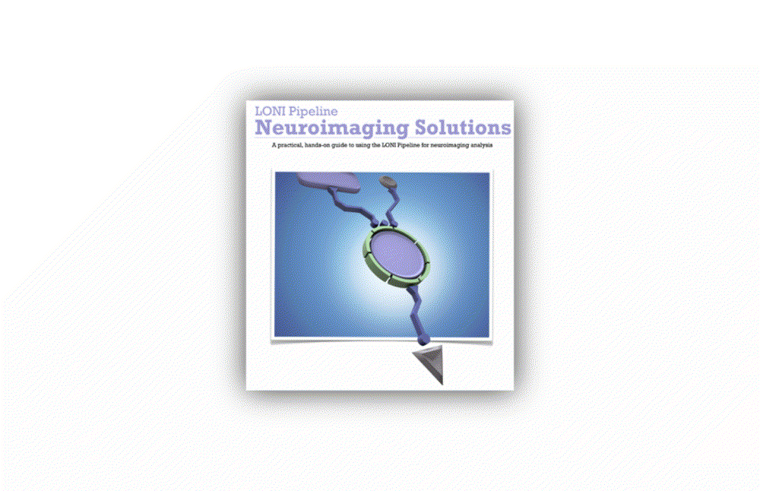
End-to-end Pipeline Workflow Solutions
Dinov, et al., 2014, Front. Neuroinform.; Dinov, et al., Brain Imaging & Behavior, 2013
Notes:
Big Data has intrinsically multi-dimensional characteristics …

Slide 18
Predictive Big Data Analytics in Parkinson’s Disease
A unique archive of Big Data: Parkinson’s Progression Markers Initiative (PPMI). Defining data characteristics – large size, incongruency, incompleteness, complexity, multiplicity of scales, and heterogeneity of information-generating sources (imaging, genetics, clinical, demographic)
Approach
introduce methods for rebalancing imbalanced cohorts,
utilize a wide spectrum of classification methods to generate phenotypic predictions,
reproducible machine-learning based classification
Results of machine-learning based classification show significant power to predict Parkinson’s disease in the PPMI subjects (consistent accuracy, sensitivity, and specificity exceeding 96%, confirmed using internal statistical 5-fold cross-validation). Clinical (e.g., Unified Parkinson's Disease Rating Scale (UPDRS) scores), demographic (e.g., age), genetics (e.g., rs34637584, chr12), and derived neuroimaging biomarker (e.g., cerebellum shape index) data all contributed to the predictive analytics and diagnostic forecasting.
Model-free Big Data machine learning-based classification methods (e.g., adaptive boosting, support vector machines) outperform model-based techniques (GEE, GLM, MEM) in terms of predictive precision and reliability (e.g., forecasting patient diagnosis). UPDRS scores play a critical role in predicting diagnosis, which is expected based on the clinical definition of Parkinson’s disease. Even without longitudinal UPDRS data, however, the accuracy of model-free machine learning based classification is over 80%. The methods, software and protocols developed here are openly shared and can be employed to study other neurodegenerative disorders (e.g., Alzheimer’s, Huntington’s).
Dinov, et al., PLoS, 2016
Notes:
Imputation: In our experiments, we used the R-packages MICE (MI via chained equations) and MI to perform $m=5$ chained imputations.
Imbalanced Sample-Sizes: The R package SMOTE (Synthetic Minority Over-sampling TEchnique) facilitated the group rebalancing of the native imbalanced cohorts by creating synthetic instances of the under sampled class (e.g., controls).
Stratification: Most of our cohort comparisons were done on stratified data – by cohort-definition (HC vs PDs, or HC vs. Patients (PDs + SWEDDs)) and by cohort-size (raw unbalanced comparisons, or comparisons of SMOTE-rebalanced group sizes).

Slide 19
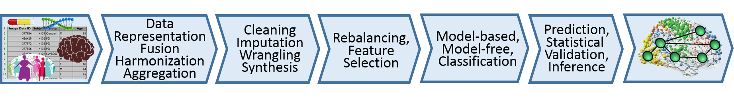
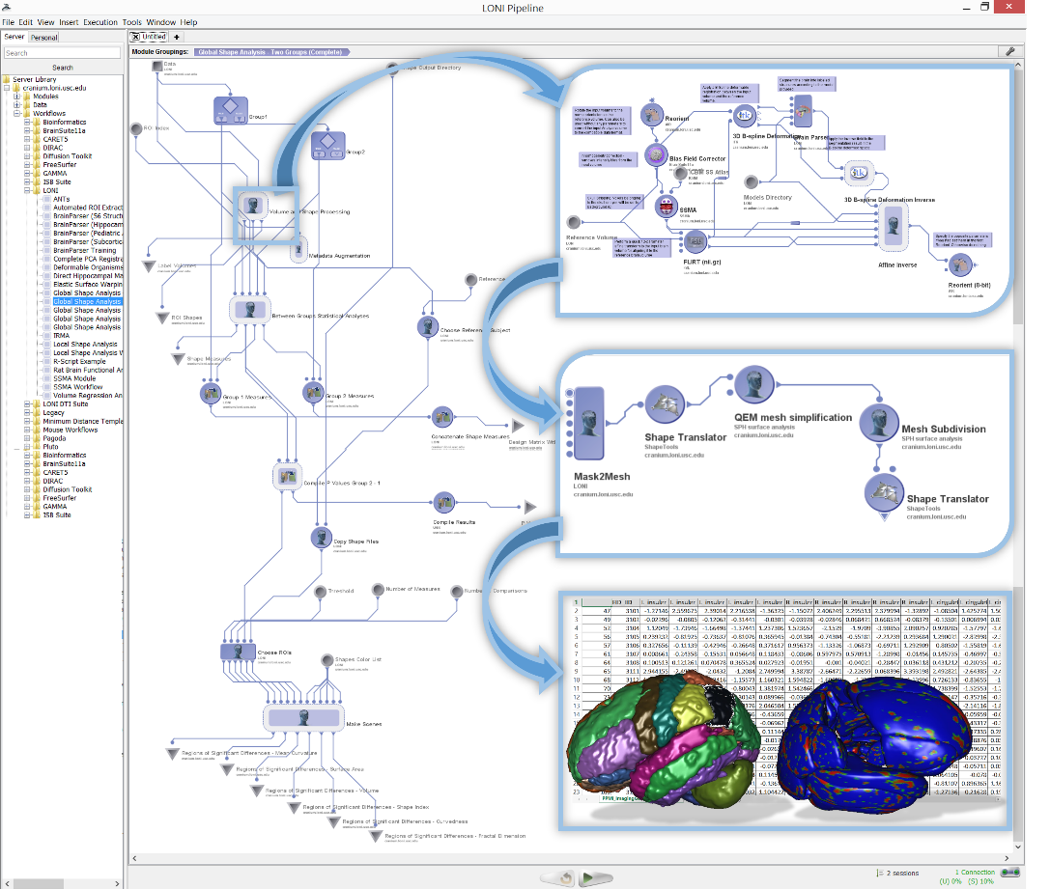
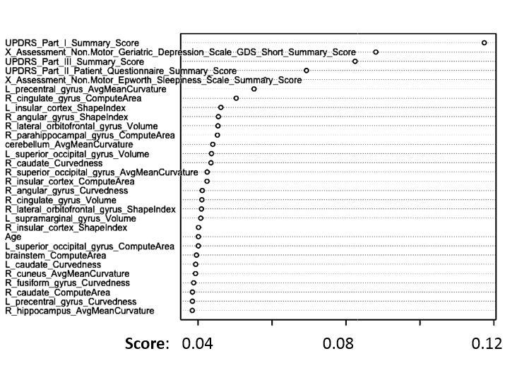
Predictive Big Data Analytics: Applications to Parkinson’s Disease
Varplot illustrating:
the critical predictive data elements (Y-axis)
and their impact scores (X-axis)
AdaBoost classifier for Controls vs. Patients prediction
ML classifier | accuracy | sensitivity | specificity | positive predictive value | negative predictive value | log odds ratio (LOR)
AdaBoost | 0.996324 | 0.994141 | 0.998264 | 0.9980392 | 0.9948097 | 11.4882058
SVM | 0.985294 | 0.994140 | 0.977431 | 0.9750958 | 0.9946996 | 8.902166
Dinov, et al., PLoS, 2016

Slide 20
Predictive Big Data Analytics: Applications to Parkinson’s Disease
Best Machine Learning Based Classification Results (according to average measures of 5-fold cross-validation)
Data Strata | Classifier | FP | TP | TN | FN | Accu-racy | Sensi-tivity | Speci-ficity | positive predictive value | negative predictive value | log odds ratio (LOR)
balanced control/PD | ada | 0.2 | 102 | 115 | 0.6 | 0.99632 | 0.99414 | 0.99826 | 0.998039 | 0.9948097 | 11.4882
balanced control/PD | svm | 2.6 | 102 | 113 | 0.6 | 0.98529 | 0.99414 | 0.97743 | 0.975096 | 0.9946996 | 8.902166
balanced control/PD&SWEDD | svm | 3.4 | 101 | 112 | 1 | 0.97978 | 0.99023 | 0.97049 | 0.967557 | 0.9911348 | 8.1120092
balanced control/PD&SWEDD | ada | 1.4 | 101 | 114 | 1.8 | 0.98529 | 0.98242 | 0.98785 | 0.986275 | 0.9844291 | 8.4214
unbalanced control/PD | ada | 0.2 | 25 | 54 | 0.8 | 0.98753 | 0.96875 | 0.99634 | 0.992 | 0.9855072 | 9.039789
unbalanced control/PD&SWEDD | ada | 1.2 | 24 | 61 | 1.8 | 0.96599 | 0.92969 | 0.98083 | 0.952 | 0.971519 | 6.516987
Dinov, et al., PLoS, 2016

Slide 21
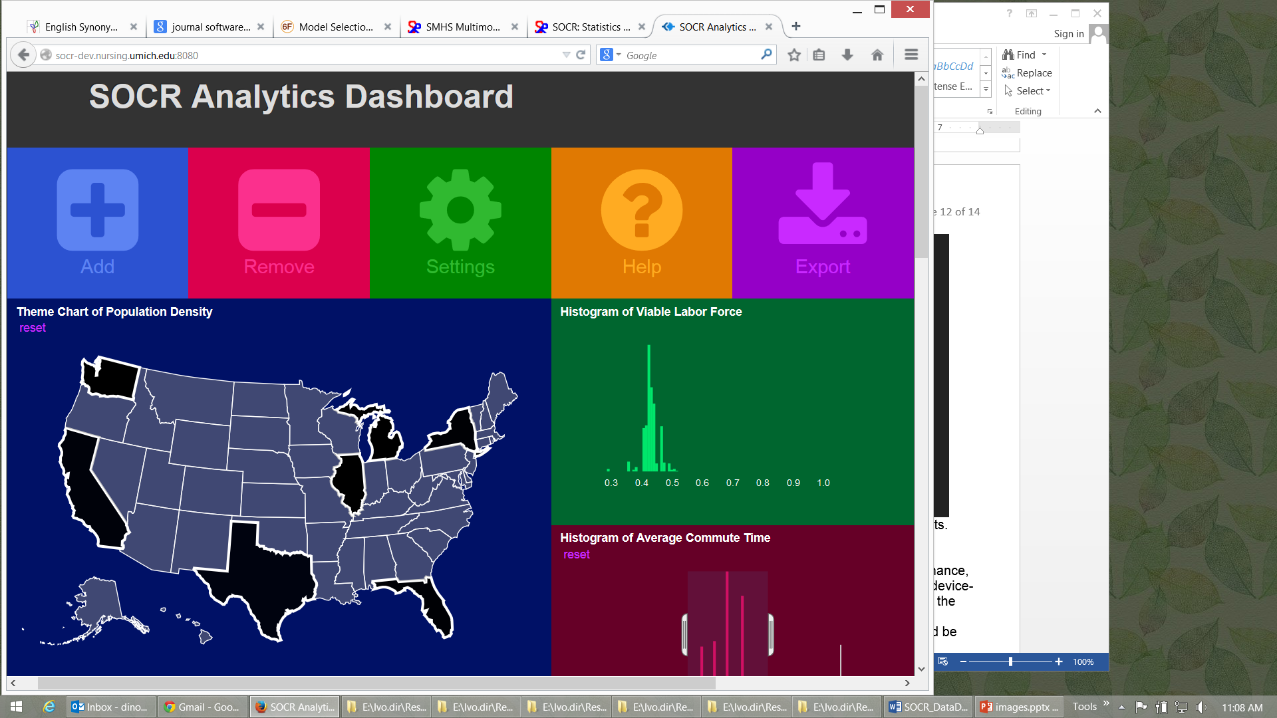
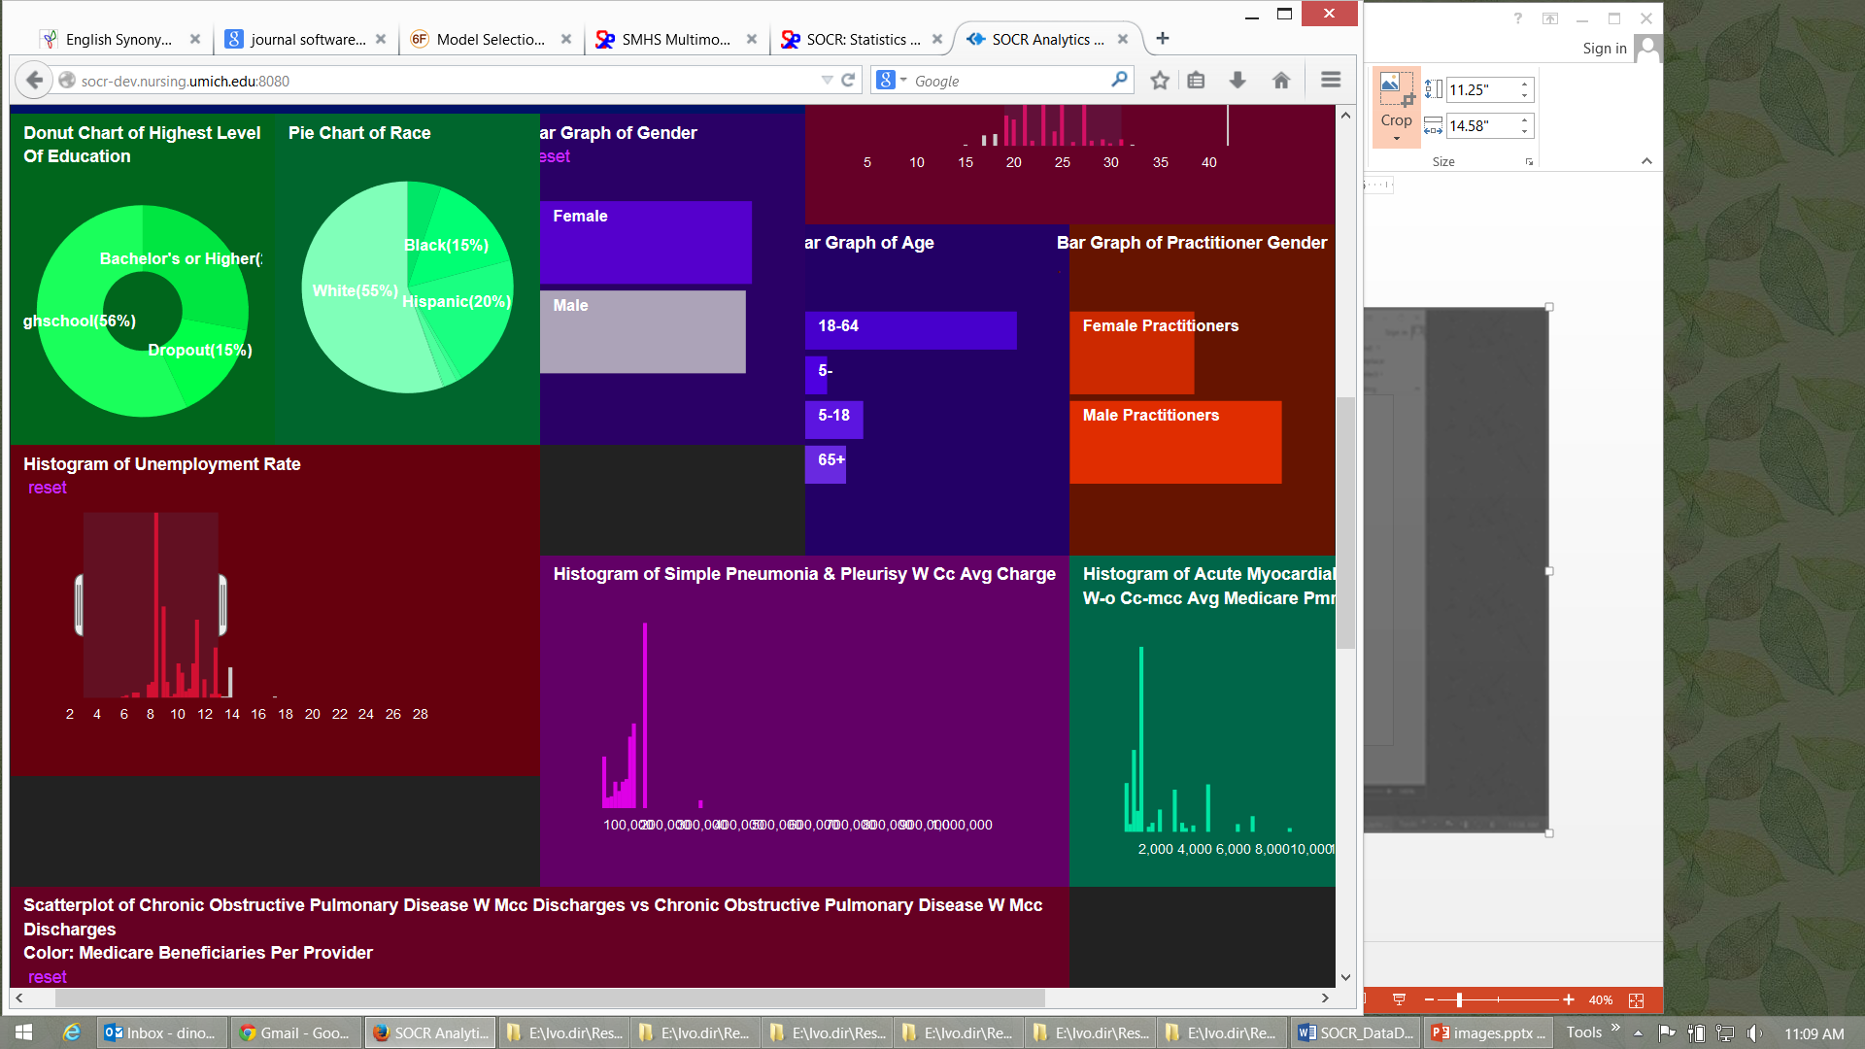
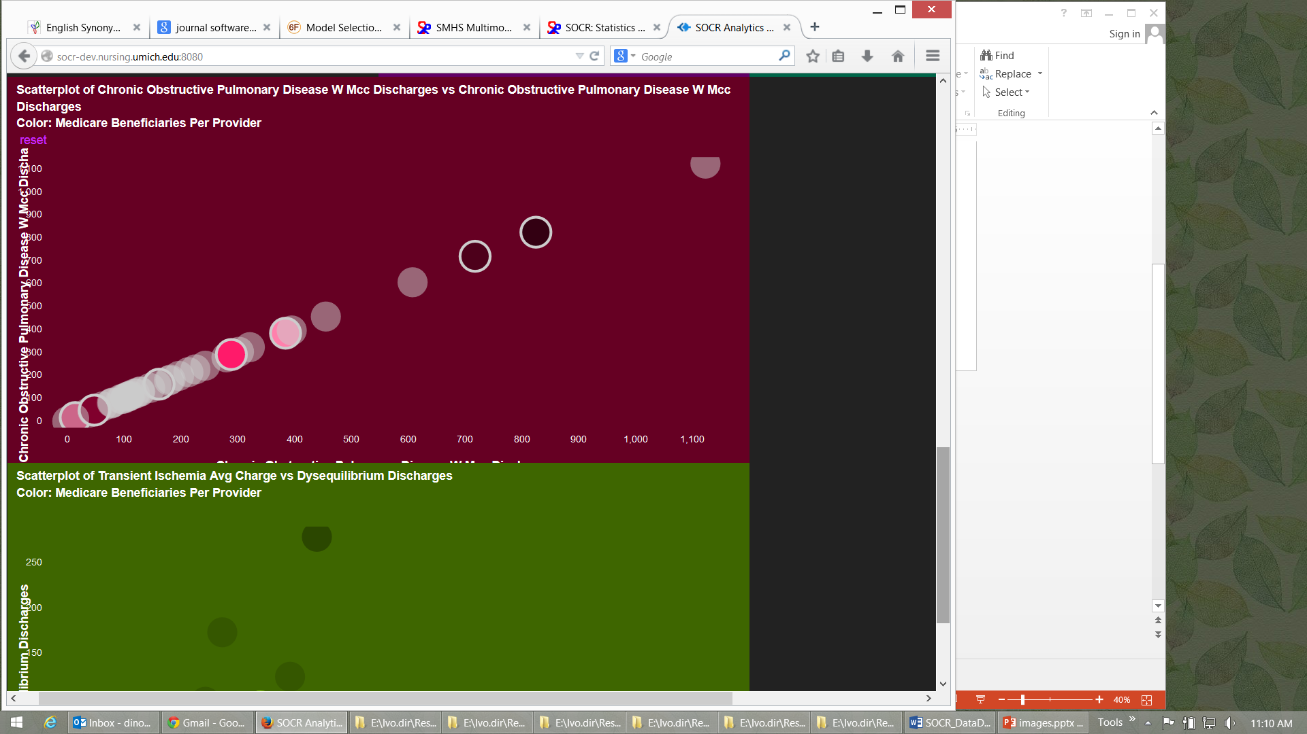
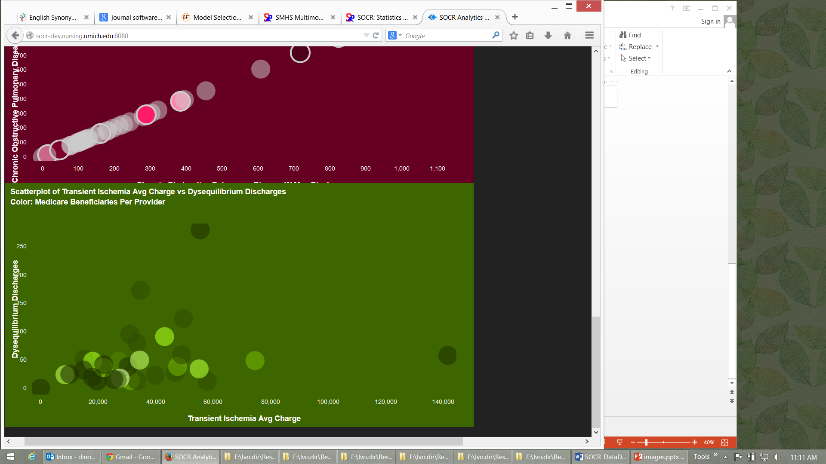
SOCR Big Data Dashboard
http://socr.umich.edu/HTML5/Dashboard
Web-service combining and integrating multi-source socioeconomic and medical datasets
Big data analytic processing
Interface for exploratory navigation, manipulation and visualization
Adding/removing of visual queries and interactive exploration of multivariate associations
Powerful HTML5 technology enabling mobile on-demand computing
Husain, et al., 2015, J Big Data

Slide 22
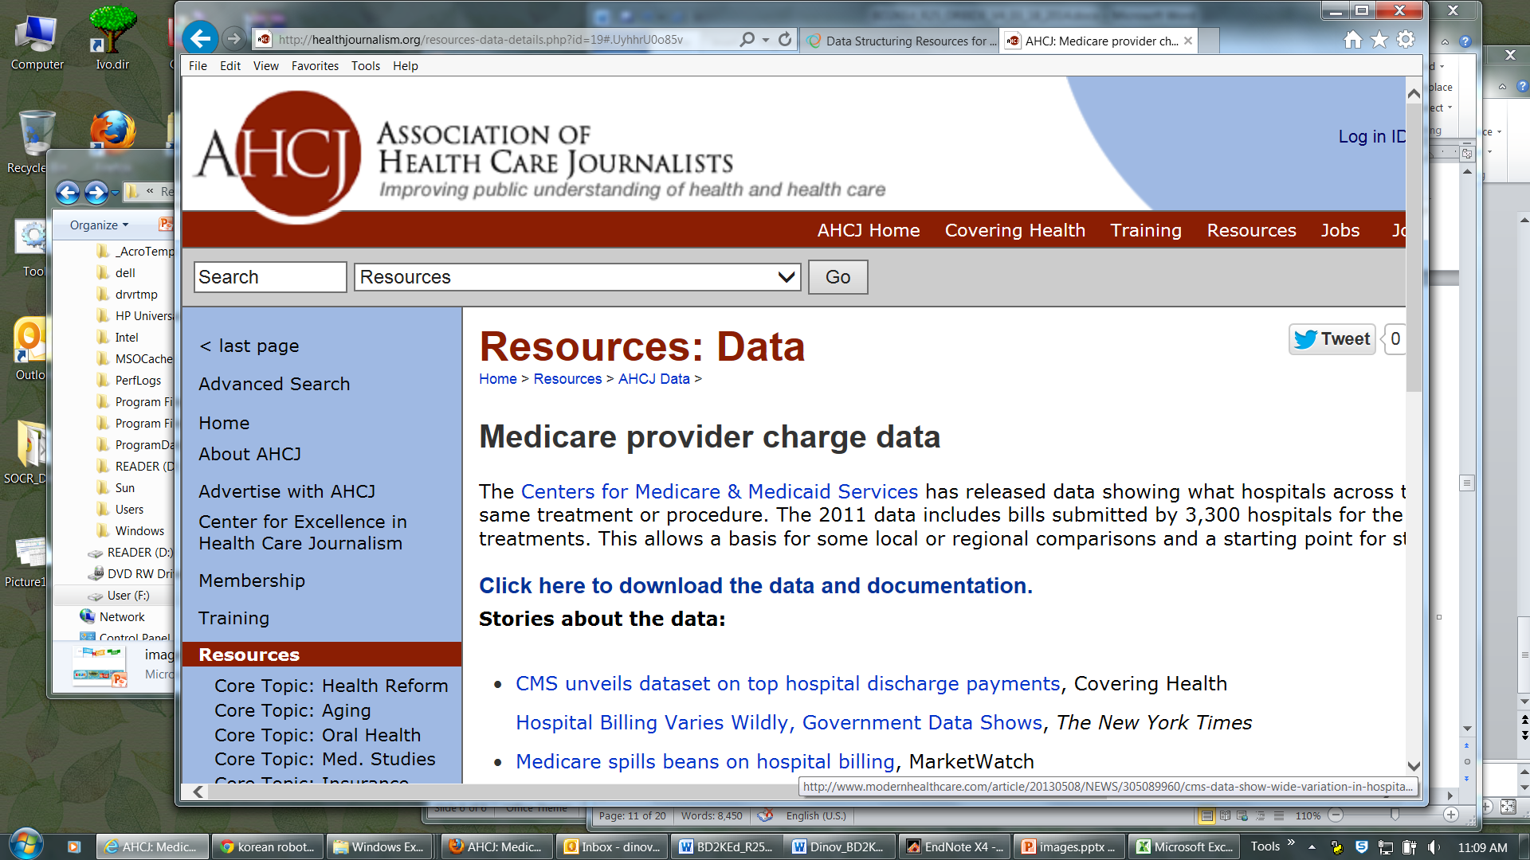
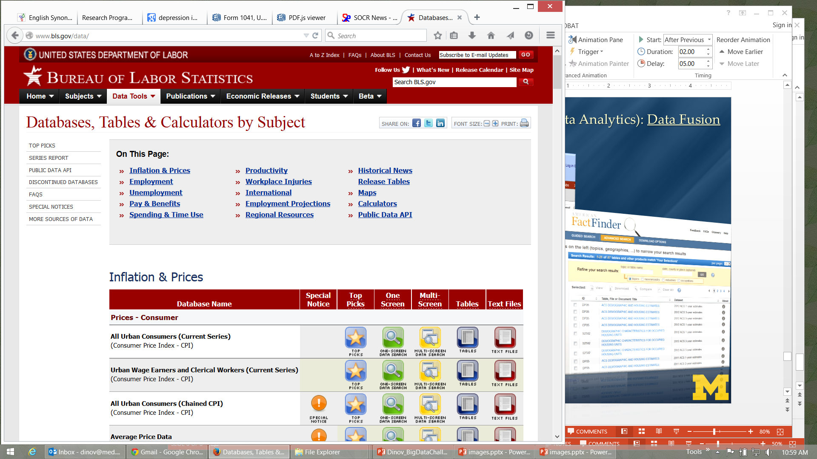
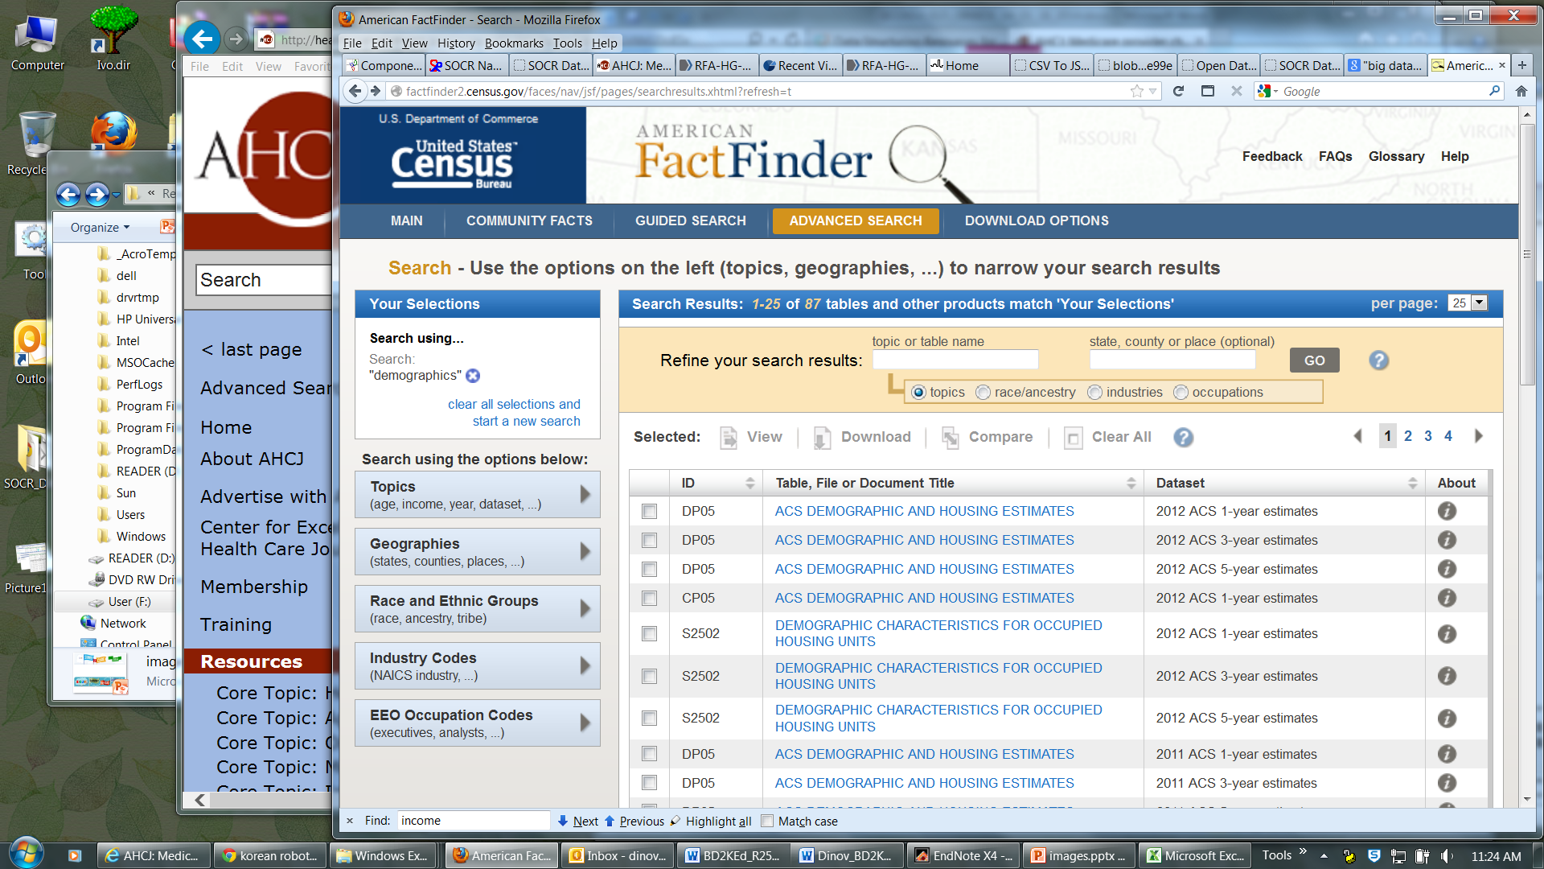
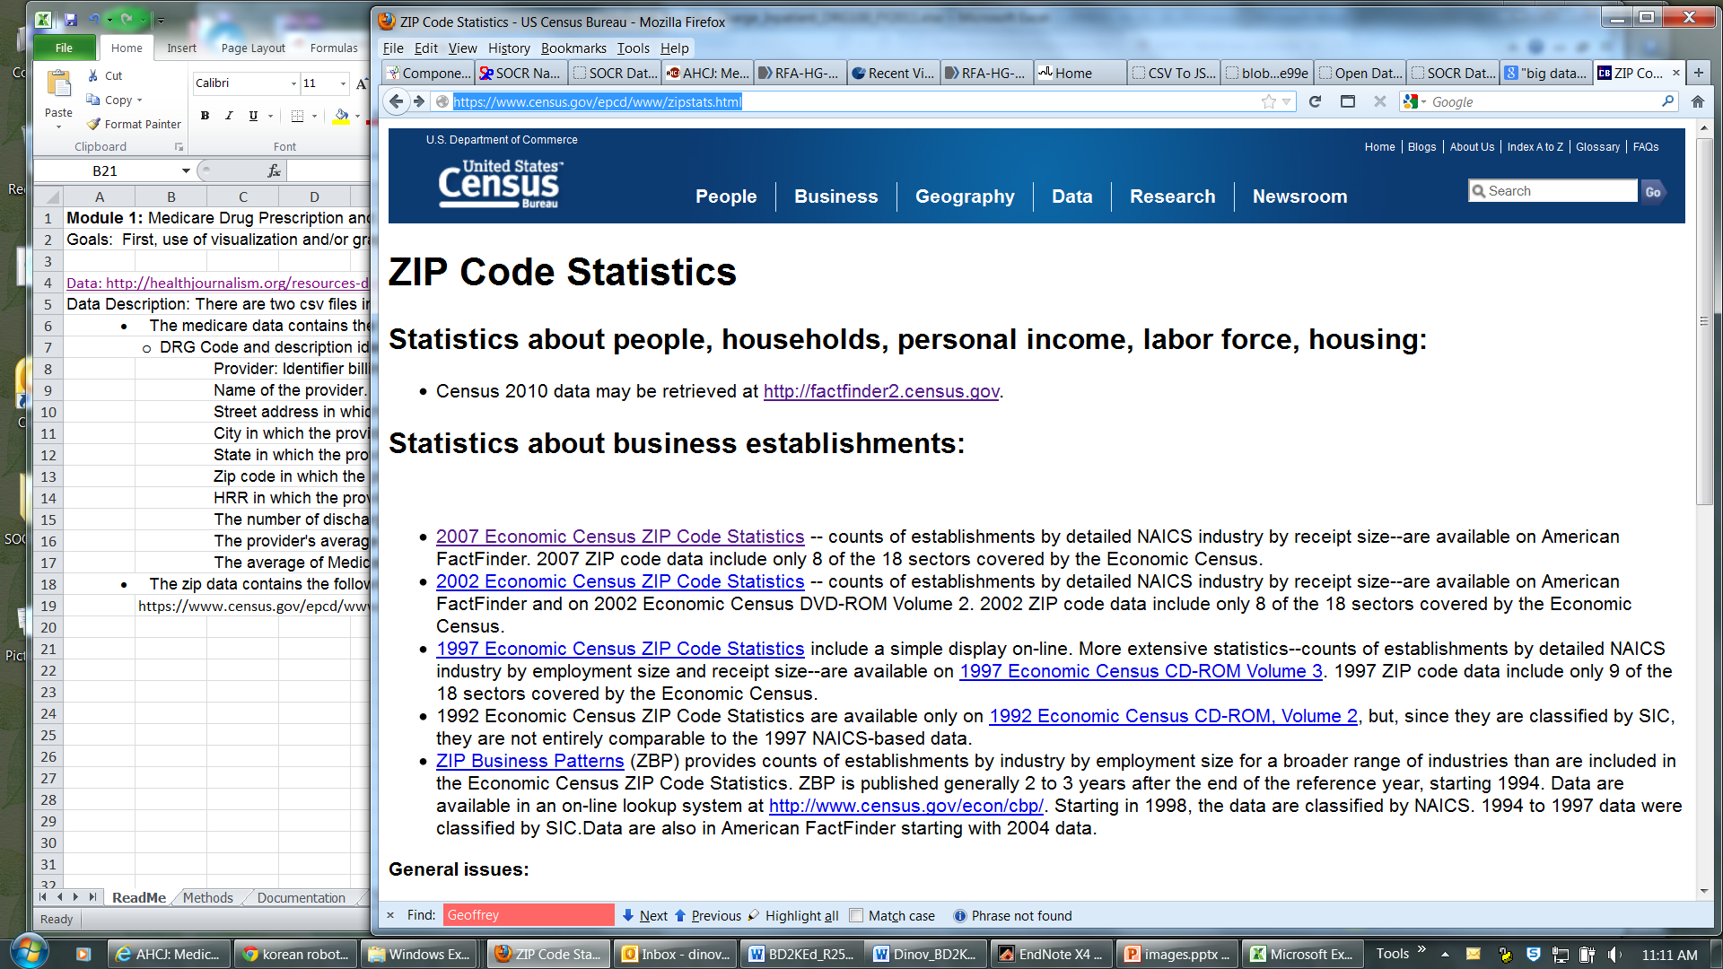
SOCR Dashboard (Exploratory Big Data Analytics): Data Fusion
http://socr.umich.edu/HTML5/Dashboard
Notes:
Imaging Pheno/Genotype Associations: Data

Slide 23
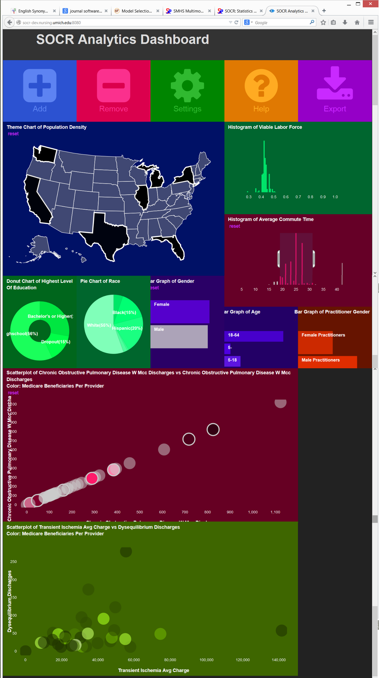
SOCR Dashboard (Exploratory Big Data Analytics): Associations
Notes:
Depression Center collaboration with Melvin McInnis and Anh Truong

Slide 24
Compressive Big Data Analytics (CBDA)
The foundation for Compressive Big Data Analytics (CBDA) involves
Iteratively generating random (sub)samples from the Big Data collection.
Then, using classical techniques to obtain model-based or non-parametric inference based on the sample.
Next, compute likelihood estimates (e.g., probability values quantifying effects, relations, sizes)
Repeat – the process continues iteratively.
Repeating the (re)sampling and inference steps many times (with or without using the results of previous iterations as priors for subsequent steps).
Dinov, J Med Stat & Info, 2016

Slide 25













Acknowledgments
NSF: 1636840, 1416953, 0716055, 1023115
NIH: P50 NS091856, P30 DK089503, P30AG053760, P20 NR015331, U54 EB020406
http://NeuroscienceNetwork.org

